Slide 1
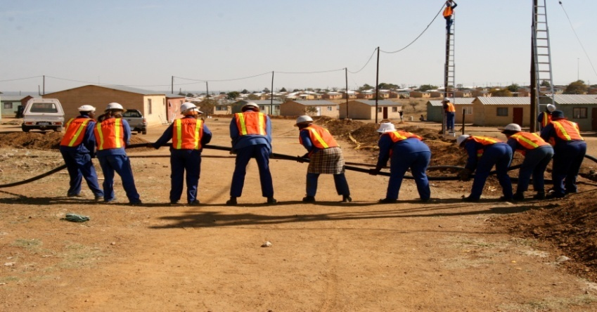
Expanded Public Works Programme Summit 27 – 28 November 2014 Commission (2) on the Implementation of Sustainable Livelihoods Facilitators: Mr M Tundzi & Mr G Sibanda Rapporteur: Mr Makgale Moela

Slide 2
Outline
How to achieve Sustainable Livelihoods within the context of EPWP?
What type of programmes/activities are required to achieve Sustainable Livelihoods?
What indicators should be used to measure SL in EPWP?

Slide 3
1. How to achieve Sustainable Livelihoods within the context of EPWP?
Action | Responsibility | Time Frames
Profile/ scan communities to determine available resources, buy in, participation and strengthen linkages and partnerships with other bodies across all government spheres (issue directive for communities to be scanned to respond on 1) | EPWP, Funding institutions, politicians to buy-in and champion the SL concepts, private sector, municipalities , | End of 2014/15 Annual updates
Identify and provide sustainable training programmes e.g. learnerships, artisan development , relevant scarce and critical skills. Award bursaries to participants | All Spheres, SOEs Ensure involvement of subject matter experts)
EPWP to develop community-based strategies to stimulate rural tourism, utilise existing creative industry fresh produce markets, Cooperatives e.g. brick manufacturing | Tourism, Municipalities
Notes:
What are sustainable livelihoods?
How does SL link with ED and training in EPWP?
Best practices for SL in EPWP?

Slide 4
1. How to achieve Sustainable Livelihoods within the context of EPWP? Cont.
Action | Responsibility | Time Frames
Conduct Impact study on EPWP participants post EPWP e.g. Professional EPWP workers what has happened to them. identify possible exit strategies. | M&E
Partner with private sector – bring in a carrot like incentives to attract them like tax rebates and breaks | NT, EDD
Develop strategies to boost contractors e.g. in procurement. Preferential tendering strategies to enhance EPWP participants – align procurement policy instruments. | CIDB, NT, NDPW
EPWP to report on sustainable livelihoods as an indicator | M&E
Existing sustainable livelihoods to be enhanced like backyard mechanics analyse the gaps and assist to fill in the gaps.
Notes:
What are sustainable livelihoods?
How does SL link with ED and training in EPWP?
Best practices for SL in EPWP?

Slide 5
1. How to achieve Sustainable Livelihoods within the context of EPWP? Cont.
Action | Responsibility | Time Frames
Synergise with existing EPWP SL guidelines (piggy back on DSD concept/ programmes) SL should be part of programme design for EPWP 4 | EPWP Sustainable livelihoods Steering Team to Develop Guidelines and concept paper (ILO/ NDPW/ DSD, etc.) | February 2015/ framework 6 months/ roll-out
Promote development of community co-operatives and link them to support institutions such as SEDA | The DTI, Dept of Small Bus Dev | 5-years
Incorporate exit strategies and provide linkages into projects planning | Funding institutions, implementing bodies | Continuous
Partnership with the private sector (this requires skilled deal makers and negotiators who will negotiate on behalf of Govt.) – incentives, tax rebates, etc | All | Continuous
Engage on inhibiting treasury regulations while capitalising on the treasury regulations that empower the EPWP participants | Govt, NT, EDD | Continuous
Notes:
What are sustainable livelihoods?
How does SL link with ED and training in EPWP?
Best practices for SL in EPWP?

Slide 6
2. What type of programmes/activities are required to achieve Sustainable Livelihoods?
Action | Responsibility | Time Frames
Seasonal agro-processing work - Agric hubs, storing and school nutrition programme – selling to the fresh produce market – youth trained – permanent jobs (packaging, security, storing) longer term jobs | Agric, education, social development (infrastructure sector) | On-going
Integrated planning and enhance IGR | All | On-going
Indigenous knowledge system that could be integrated with CWP work or Get ideas from the participants themselves or pvt sector | CWP | On-going
Identify specific ideal sector programmes – convergence important to avoid overlaps. | All | On-going
Mentoring and coaching (deliberate programmes) | All | On-going
Notes:
What are sustainable livelihoods?
How does SL link with ED and training in EPWP?
Best practices for SL in EPWP?

Slide 7
3. What indicators should be used to measure SL in EPWP?
Action | Responsibility | Time Frames
Income received | Implementing and funding institutions | Ongoing
Qualifications acquired
No. of placement opportunities participants have been exposed to
Good health and improved standard of livelihoods – food security
Number of self employment entities created
Assets acquired for sustainability e.g. tourism facilities lodges, BBs, hiking trails, farms, game lodges, incl. all social capital
Non tangible benefits e.g. improved hygiene
Sustainability indicators - EPWP projects e.g. NPOs.
Integrated planning indicators
Notes:
What are sustainable livelihoods?
How does SL link with ED and training in EPWP?
Best practices for SL in EPWP?

